Slide 1


USDOL Worker Leave Simulation Model Beta Version Demonstration
December 13, 2019

Slide 2
Today
Introduction
Model Overview
Accessing the Model
Model Use Cases
Model Demonstration
Appendix. Technical Details

Slide 3
I. Introduction

Slide 4
Introduction
Background
Current states with paid leave programs: CA, NJ, NY and RI
Program will soon begin in DC & WA (2020), and CT, MA, ME, and OR (2023)
1 in 6 workers had access to employer-provided paid leave (BLS, 2018)

Slide 5
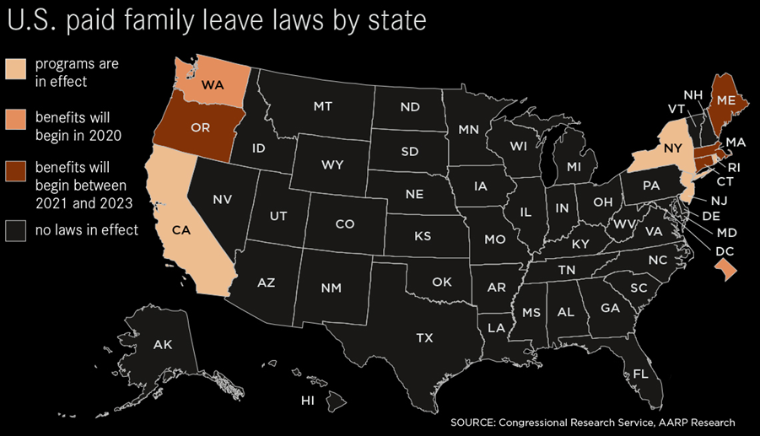
Introduction

Slide 6
Introduction
More states may follow by enacting legislation for and implementing mandatory paid family leave
Demands a rigorous evidence-based feasibility analysis

Slide 7
Introduction
A microsimulation provides a formal framework to simulate/predict workers’ leave needs, leave taking behavior, and program participation, featuring
Individual level worker characteristics and leave needs / taking
Statistical modeling / prediction / machine learning
Association between job characteristics and program participation / wage replacement
Formal aggregation of program statistics (outlay / caseloads) to state level

Slide 8
II. Model Overview

Slide 9
Model Overview
Previous Model
Project Goals
Albelda-Clayton-Matthews-IWPR (ACM-IWPR) model
IMPAQ-IWPR model
FMLA/ACS data
Built in C++
Closed Source
Lacks transparency for analysis/development
FMLA/ACS data
Built in Python/R
Open source, full transparency
Baseline validation
Improved performance
Ease of use

Slide 10
Model Overview
User Input
GUI
Population Analysis
Policy Simulation
ACS
Post-simulation ACS
Counterfactual Simulation
Cost Analysis
FMLA Employee Survey
Trained Models
ABF Module
Sandbox Capabilities
Model Training

Slide 11
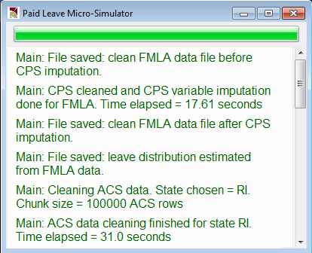
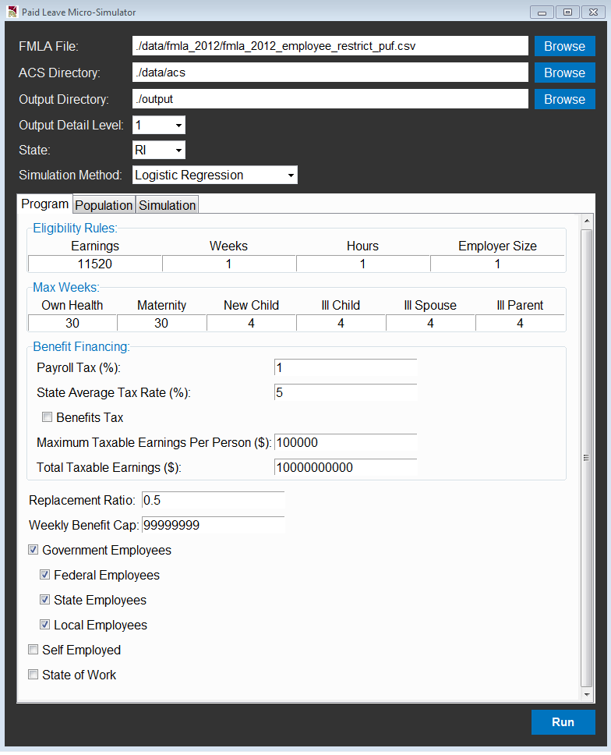
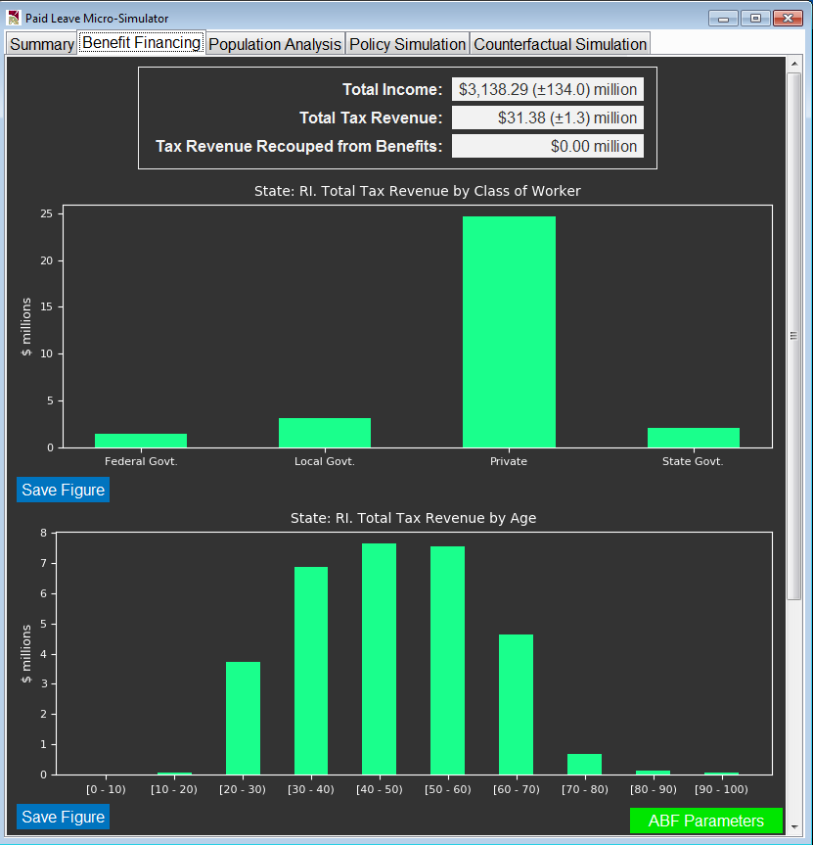
Model Overview

Slide 12
Examples of Model Use
Possible Uses:
Population analysis: Our model can be used to analyze what happens to a group of workers (e.g., female workers of child bearing age)
Policy simulation: Our model can be used to simulate a leave policy (e.g. what would happen if all workers from California are given leave? How many would take it up? What would their leave taking behavior look like?)

Slide 13
Examples of Model Use
Possible Uses:
Counterfactual simulation: Our model can be used to simulate a counterfactual scenario (e.g. what would happen to Vermont if it adopts California rules?)
Cost Estimates : Our model can be used to estimate the cost of implementing a leave program
Sandbox: Our framework can be used to study a number of related topics:
FMLA Survey sampling variation
ML methods vs Regression-based prediction methods

Slide 14
III. Accessing the Model
Notes:
My current thought is have Mike host the GUI on a web-based Heroku app. Everyone logs into via browser, and can runs the simulation/see visualizations/download files from there.
Next few slides are a very rough concept, and will need to be tailored to the process we end up with once Mike finishes.

Slide 15
Accessing the Model
Python model
Developed and tested in Windows 7/10, Python 3.5/3.7
All modules can be easily installed via pip
Executables is available for Windows machines without Python
To launch, run following in Windows Command Line / Powershell:
python Microsimulator.py

Slide 16
Accessing the Model
R model
Developed and tested in built with R version 3.6.1, RStudio 1.2.1335, and Rtools 3.5.
Currently not integrated with GUI (final model will be). To run, requires modifying and executing an R script with your desired parameters.
Tutorial included to demonstrate how
All dependent packages are automatically installed when run, if not already present (requires internet access)

Slide 17
Accessing the Model
User Manuals
Provide step-by-step detailed instructions to install and run model
Full data dictionary for derived variables
Coding transparency / Collaboration
Code stored on Github repository
Full transparency and availability for researchers/programmers
Flexibility for future development

Slide 18
IV. Model Use Cases

Slide 19
Demonstration Scenarios
We will go through 3 scenarios to demonstrate different uses of the model:
Program Cost Estimation
Program’s Impact on Low-Wage Workers
Program’s Economic Cost & Impact

Slide 20
Scenario 1 – Program Cost Estimation
Consider state of Maryland (currently no program)
Assume state is considering implementing
State likes how Rhode Island’s program is set up and would like to know the implication of replicating RI program in MD

Slide 21
Scenario 1 – Program Cost Estimation
How much for MD to budget for benefits?
Other state programs pay out very different amounts
Due to differences in population, program generosity

Slide 22
Scenario 1 – Program Cost Estimation
We can use the model to simulate
At worker level:
leave taking
leave needs
program take up
At state level (derived from microsimulation):
program benefits outlays
program financing
caseloads

Slide 23
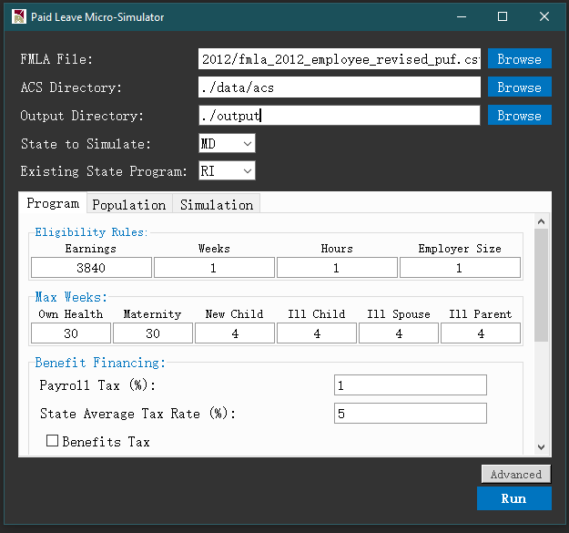
Scenario 1 – Program Cost Estimation
To simulate, set State to Simulate = “MD”, and Existing State Program = “RI”
Model will use ACS PUMS for MD
Parameters under Program tab will be auto-populated as RI program parameters

Slide 24
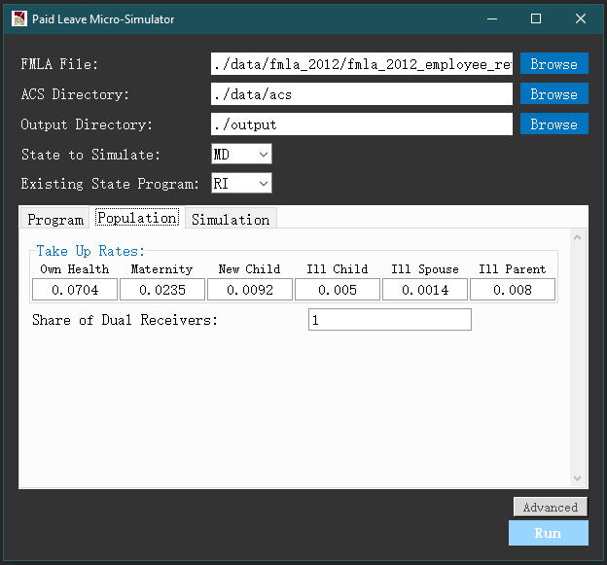


Scenario 1 – Program Cost Estimation
Specify population parameters
$$\frac{\text{\# }\text{paid} \text{cases}}{\text{\# }\text{eligible} \text{workers}}$$
$$\frac{\begin{aligned}\text{\# }\text{workers} \text{who} \text{can} \text{receive} \text{state} \text{and} \\ \text{employer} \text{benefits} \text{simultaneously}\end{aligned}}{\text{\# }\text{workers} \text{who} \text{receive} \text{any} \text{employer} \text{benefits}}$$

Slide 25
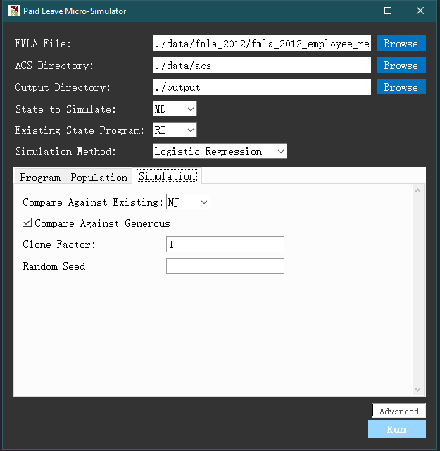
Scenario 1 – Program Cost Estimation
Specify simulation parameters
Option to run separate simulation with alternative state program parameters
Menu of classifiers:
Logit
Ridge
KNN
Naïve Bayes
SVM
Random Forest
Option to run separate simulation with most generous program features (full replacement, min eligibility req’t)
Integer factor to repeat ACS sample while reducing weight to get more granular simulation outcomes
Option to show/hide advanced options
Random seed for replication

Slide 26
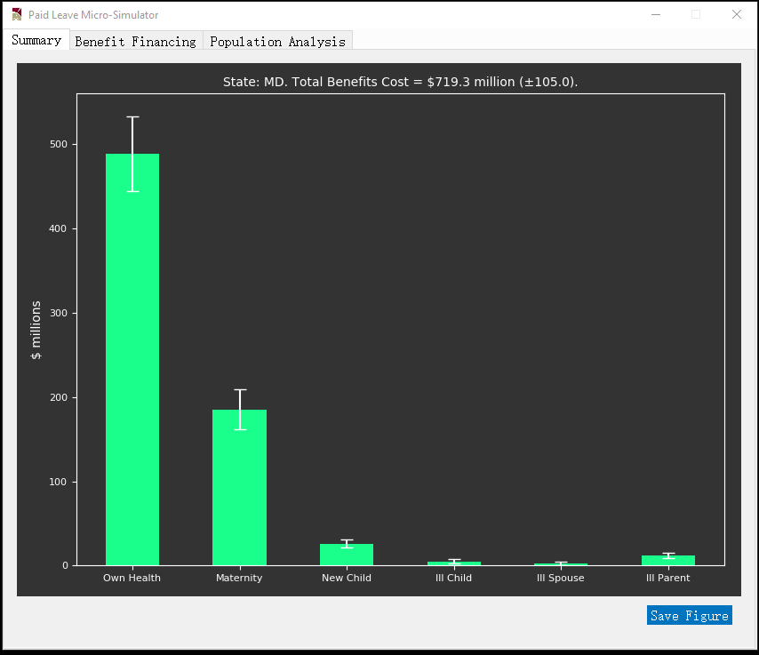
Scenario 1 – Program Cost Estimation
Total program outlay

Slide 27
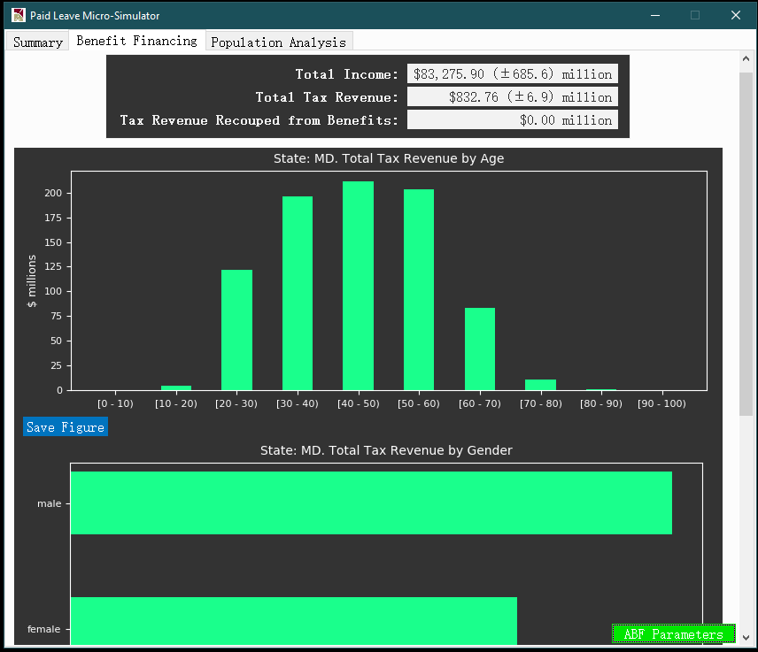
Scenario 1 – Program Cost Estimation
Program financing – Overall / Subgroup breakdown

Slide 28
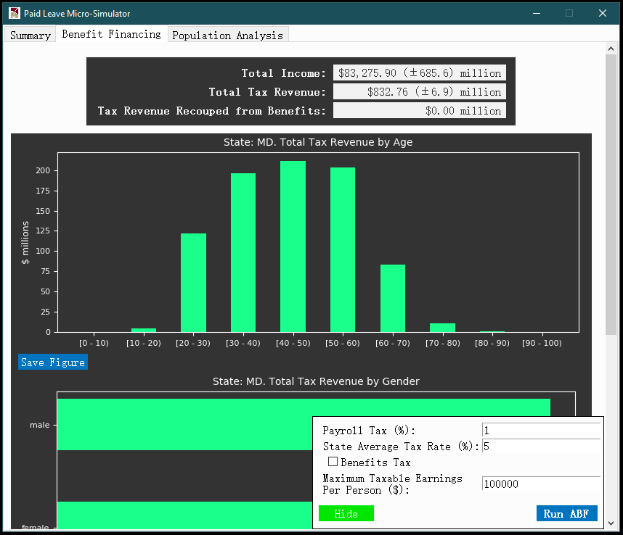
Scenario 1 – Program Cost Estimation
Program financing – option to re-run ABF module
Option to re-run ABF module with alternative payroll tax schemes

Slide 29
Scenario 2 – Impact on Lower-Wage Workers
One of policy goals of state might be to support lower wage workers with paid leaves
Can estimate the impact of program on these workers by analyzing the output micro-level data set from simulation
For example, defined “low-income” as <200% of the MD poverty line

Slide 30
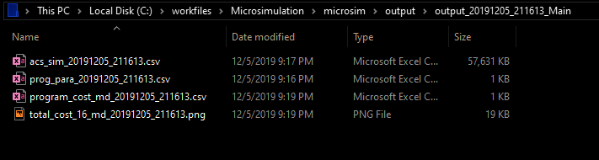
Scenario 2 – Impact on Lower-Wage Workers
Output micro-level data set is auto-saved at
./output/output_[yyyymmdd]_[hhmmss]_Main
where yyyymmdd and hhmmss denote date and timestamp that uniquely identifies each simulation run
output micro dataset

Slide 31
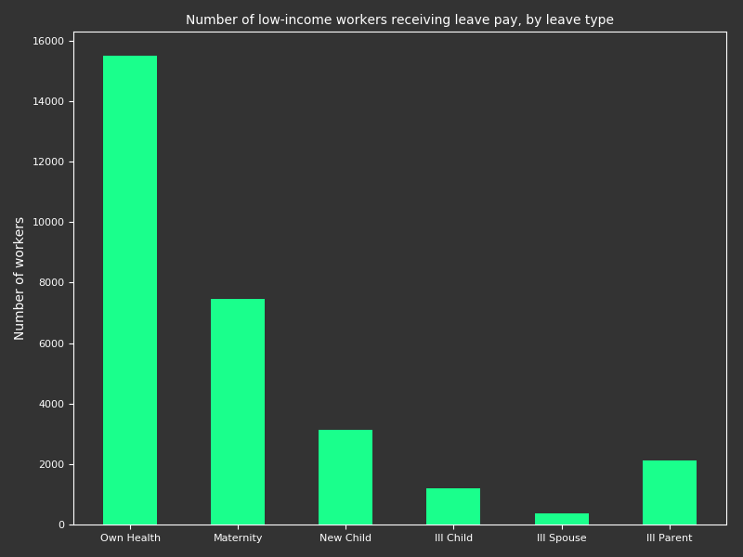
Scenario 2 – Impact on Lower-Wage Workers
How many low-income individuals would get benefits?

Slide 32
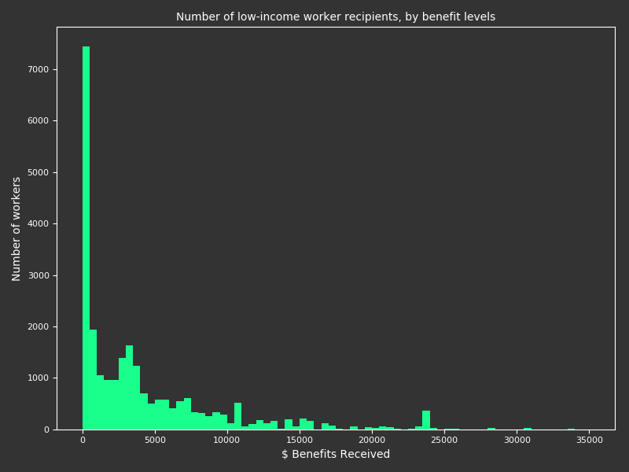
Scenario 2 – Impact on Lower-Wage Workers
How much benefit would go to low-income worker families?

Slide 33
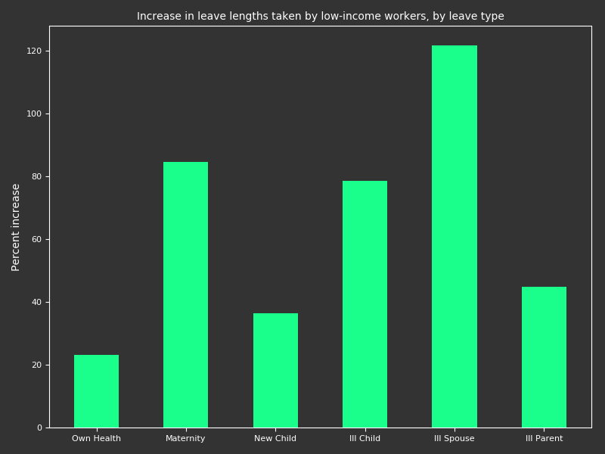
Scenario 2 – Impact on Lower-Wage Workers
How much more leave taking would low-income workers choose?

Slide 34
Scenario 3 – Overall Economic Cost & Impact
More generally, what would be the economic costs and benefits of this program?
Direct Benefits | Indirect Benefits
Wage replacement | Health outcomes Attachment to job Household economic security Child development Substitution effects on other programs (TANF/SNAP/Institutional Care for Elderly) Promotes labor force participation and long term economic growth
Direct benefits and costs can be estimated from simulation output
Direct Costs | Indirect Costs
Program outlay Administrative costs | Deadweight loss from tax Forgone productivity during leave

Slide 35
Scenario 3 – Overall Economic Cost & Impact
Indirect benefits and costs can be examined by comparing magnitude of program intervention in simulation and programs studied in literature
For example, 1 more month of maternity leave may increase odds of higher performance in Motor and Social Development scale by 3% (Sherlock et al. 2008)
Our simulation shows median increase (if any) in maternity leave among MD workers under RI program is 30 days
Can expect an effect on child performance comparable to magnitude found in literature

Slide 36
Scenario 3 – Overall Economic Cost & Impact
Indirect benefits and costs can be examined by comparing magnitude of program intervention in simulation and programs studied in literature
Similar projections can be made across different benefit / cost categories
We are compiling literature to build a framework that would allow model users to perform a full suite of economic impact analysis

Slide 37
Questions?

Slide 38
V. Model Demonstration

Slide 39
Feedback
What kinds of research questions would be of most interest to you?
What features would help make this more useful?
How could you see this model being used in your future research?

Slide 40
Appendix. Technical Details

Slide 41
Model Structure
Part 1
Starts with FMLA 2012 Survey data
Train models for 13 outcomes using the FMLA Survey data
Obtains probabilities associated with leave taking behavior conditional on some observable x
Uses regression coefficients on a American Community Survey (ACS) sample to predict/impute conditional on observable x in the ACS
Update when new FMLA Survey data are available

Slide 42
Model Structure
Part 1 Assumes 6 Leave Types x (Take, Need)
k | Leave Taking | k | Leave Needing
1 | Own health | 7 | Own health
2 | Maternity | 8 | Maternity
3 | Newborn child | 9 | Newborn child
4 | Ill child | 10 | Ill child
5 | Ill spouse | 11 | Ill spouse
6 | Ill parent | 12 | Ill parent

Slide 43
Model Structure
Part 1 Assumes a ‘positive responsiveness’ variable (k=13)
A binary variable, =1 if worker would increase leave length under a more generous program
0/1 value determined by all FMLA variables about whether leave taking is financially constrained
Set to 0 for FMLA workers without leave needs
Responsive workers (=1) will take longer leaves with new program / more generous program.
How much longer? - a function of program parameters.

Slide 44
Model Structure
Our Current Model: 12 events (take_own, need_own,…), 1 responsiveness (resp_len)
$$y_{k}=\left\{\begin{aligned}1, Yes, event k occurs, or would respond \\ 0, No, did not occur, or would not respond\end{aligned}\right.$$
$p_{k}(x)=ℙ\left\{y_{k}=1|x\right\}$ $probability that$ $y_{k}$ $occurs given x$
Example: $k=1 \left(taking leave for own health\right)$
$p_{1}(x)=$Probability of taking leave for own health if you have characteristic $x$

Slide 45
Model Structure
Our Current Model: Summary
$$y_{k}^{i}=\left\{\begin{aligned}1, f_{k}\left(x^{i}\right)+ε_{i}>0 \\ 0, f_{k}\left(x^{i}\right)+ε_{i}≤0\end{aligned}\right.$$
Starts with this
$y_{k}^{i}=$ Indicator of outcome $k$ for individual $i$.
$x^{i}=$ Set of characteristics associated to individual $i$.
$ε_{i}=$ Random noise associated to individual $i$.

Slide 46
Model Structure
Part 1 Summary
FMLA Survey Data $(y_{k}^{i} , x^{i})$
National/Local Estimates of $(y_{k}^{i})$
Prediction Method $f_{k}(x^{i})$
Apply $β_{k}$ to ACS Samples $(x^{i})$
Estimated Parameters $β_{k}$

Slide 47
The Model: Structure
Part 2 Summary
Administrative Benefits and Financing (ABF) module
Uses the probabilities and counts estimated from model Part 1.
Computes various costs associated with a paid leave program.

Slide 48
Methods Options
Methods Implemented
Logistic Regression
Support Vector Machine
K Nearest Neighbor
Ridge Classifier
Naïve Bayes
Random Forest

Slide 49
Methods Options
Forthcoming
Traditional methods
Cell Mean
Random Within Cell Hot Deck
Nearest Neighbor WCHD
k-NN Cell Mean
Fuzzy k-mean
Bayesian Nested HM
Multinomial Regression
Singular Value Decomposition
Bayesian PCA
MICE
Chained Equations with GLMs
Chain Eq. Using Classification
FBJD-DPMM
Machine learning methods
LQDA
Gaussian Processes
Decision Trees
Multiplayer Perceptron

Slide 50
ABF Module Process Flow
Start with Simulation Output
PROGRAM FUNDING
Estimate Administrative Start-Up & Ongoing Costs
Staffing Costs
Technology infrastructure
Capital (office space, computers)
Public Awareness Campaigns
Paid Leave Benefits
What types of employers/employees contribute?
Taxable wage base?
Simulate Payroll Tax Rate to cover the costs
Leave use &
Paid Leave Benefits
Total Program Costs

Slide 51
ABF Module
Provides a platform for:
Planning & Estimation of Administrative cost
Cost Guidance Document that summarizes costs estimates from past leave program
Shared insights from current leave administrators
Excel Spreadsheet for users to plan the setting up of a leave administrative unit (staffing, technology, etc.)
Payroll Tax simulation for Program funds
Users can simulate tax revenue estimates based on different payroll tax rate to reach a target or cover total costs
Part of the Microsimulation GUI

Slide 52
ABF Cost Guidance Document
A comprehensive starter guide for planning administrative costs of a family leave program
Provides cost factors & estimates observed from states with current leave programs
Incorporates information from interviews of leave program administrators
Overall intends to provide some thinking material or ballpark estimates to policy planners
Document is based on extensive review of State Feasibility studies, Budget reports, Publically available leave data reports

Slide 53
ABF Cost Guidance Document
Provides insights on the minimum to account for start-up as well as on-going costs
Claim volumes growth observed across states
Range of FTE to claims ratio observed across states.
Staffing mix in administrative units across past states
Changes in staffing over years as observed in past states
IT as well as claim adjudication experience from state interviews
User will have this comprehensive information to guide her assumptions

Slide 54
Example: Ongoing Costs of current states programs
State Feasibility Study | Total FTE Year 3 | Program Size (claims per year) | Total FTE to Claims Ratio | Total Costs Year 3
Vermont | 36.5 | 15,525 | 1 FTE to 425 claims | $1.9M
Hawaii | 14.6 | 8,970 | 1 FTE to 598 claims | $0.9M
Connecticut (full operating capacity) | 120 | 100,000 | 1 FTE to 833 claims | $18.5M
Washington (year 4 in fiscal note) | 111.4 | 156,000? | 1 FTE to 1,400 | $15.8M
Colorado | 20 | 75,000 | 1 FTE per 3750 claims | $9-$12M
Montgomery County | 70 | 78,000 | 1 FTE per 1,114 claims | No info
Rhode Island (actual program. 2016?) | 58 | 39,863 | 1 staff to 683 claims | No info
New Jersey (actual program 2011) | ? | 30,701 | ? | $6.5M
California (actual Family Leave program SFY16-17) | ? | 260,303 | ? | ?

Slide 55
ABF Cost Excel Spreadsheet
Administrative Cost Spreadsheet (part of the model)
Based on the research on Cost guidance document
Captures and presents the cost elements in an Excel format
Starter platform for planning the administrative unit set up
Flexibility for the user to add/delete any factor, vary unit costs and easily change the staff mix over time
Excel spreadsheet provides flexibility and convenience to quickly assess the costs for any given unit without large time commitment

Slide 56
Payroll Tax Simulator
Payroll tax simulator is part of the GUI
Allows users to independently and quickly simulate different payroll taxes
Allow the user to choose the strategy and define the covered employees or employers

Slide 57
Payroll Tax Simulator – Tax Parameters
Taxable characteristics
Govt. or Private
Self-employed
Employer size
Place of work
Taxable wage limits
Cap on annual payroll deduction

Slide 58
Payroll Tax Simulator – Simulate tax rates
Based on the defined tax parameters, the ABF simulates the tax revenue generated
The tool uses ACS to filter the sub-population of interest
User-friendly to change the payroll tax rate to obtain alternative estimates
Generates exhibits & tables into a Word document to allow users to share results and observation easily

Slide 59
Appendix
Simulation Methods: Cell Mean (CM)
Key Concept:
FMLA $→$ Partition according to similar characteristics.
ACS $→$ Partition in a similar manner.
Leave taking behavior for ACS estimated by mean of corresponding group in FMLA.

Slide 60
Appendix
Simulation Methods: Cell Mean (CM)
Example:
 |  |  | Leave Characteristics |  | Auxiliary Data (Z)
Cell | Individual | Survey | Count | Duration | Age | Education | Gender | Experience
Y1 | 1 | FMLA | 2 | 12 | 26 | 12 | M | 4
Y2 | 2 | FMLA | 3 | 14 | 23 | 16 | F | 1
Y2 | 3 | FMLA | 5 | 13 | 22 | 16 | F | 1
O1 | 4 | FMLA | 1 | 20 | 55 | 18 | M | 30
O1 | 5 | FMLA | 1 | 30 | 48 | 22 | M | 20
Y3 | 1 | ACS |  |  | 22 | 16 | F | 1
Y3 | 2 | ACS |  |  | 28 | 18 | F | 4
Y4 | 3 | ACS |  |  | 23 | 18 | M | 1

Slide 61
Appendix
Simulation Methods: Cell Mean (CM)
Example:
 |  |  | Leave Characteristics |  | Auxiliary Data (Z)
Cell | Individual | Survey | Count | Duration | Age | Education | Gender | Experience
Y1 | 1 | FMLA | 2 | 12 | 26 | 12 | M | 4
Y2 | 2 | FMLA | 3 | 14 | 23 | 16 | F | 1
Y2 | 3 | FMLA | 5 | 13 | 22 | 16 | F | 1
O1 | 4 | FMLA | 1 | 20 | 55 | 18 | M | 30
O1 | 5 | FMLA | 1 | 30 | 48 | 22 | M | 20
Y3 | 1 | ACS | 4 | 13.5 | 22 | 16 | F | 1
Y3 | 2 | ACS | 4 | 13.5 | 28 | 18 | F | 4
Y4 | 3 | ACS |  |  | 23 | 18 | M | 1

Slide 62
Appendix
Simulation Methods: Cell Mean (CM)
Advantages:
Allows for continuous variables to be imputed.
Very fast.
Minimal computational requirements.
Disadvantages:
Attenuation effect.
Imposed independence.
Imposed dependence.

Slide 63
Appendix
Simulation Methods: Random Within Cell Hot-Deck
Key Concept:
FMLA $→$ Partition according to similar characteristics.
ACS $→$ Partition in a similar manner.
Leave taking behavior for ACS estimated by random selection of individual of corresponding group in FMLA.

Slide 64
Appendix
Simulation Methods: Random Within Cell Hot-Deck
Example:
 |  |  | Leave Characteristics |  | Auxiliary Data (Z)
Cell | Individual | Survey | Count | Duration | Age | Education | Gender | Experience
Y1 | 1 | FMLA | 2 | 12 | 26 | 12 | M | 4
Y2 | 2 | FMLA | 3 | 14 | 23 | 16 | F | 1
Y2 | 3 | FMLA | 5 | 13 | 22 | 16 | F | 1
O1 | 4 | FMLA | 1 | 20 | 55 | 18 | M | 30
O1 | 5 | FMLA | 1 | 30 | 48 | 22 | M | 20
Y3 | 1 | ACS |  |  | 22 | 16 | F | 1
Y3 | 2 | ACS |  |  | 28 | 18 | F | 4
Y4 | 3 | ACS |  |  | 23 | 18 | M | 1

Slide 65
Appendix
Simulation Methods: Random Within Cell Hot-Deck
Example:
 |  |  | Leave Characteristics |  | Auxiliary Data (Z)
Cell | Individual | Survey | Count | Duration | Age | Education | Gender | Experience
Y1 | 1 | FMLA | 2 | 12 | 26 | 12 | M | 4
Y2 | 2 | FMLA | 3 | 14 | 23 | 16 | F | 1
Y2 | 3 | FMLA | 5 | 13 | 22 | 16 | F | 1
O1 | 4 | FMLA | 1 | 20 | 55 | 18 | M | 30
O1 | 5 | FMLA | 1 | 30 | 48 | 22 | M | 20
Y3 | 1 | ACS | 3 | 14 | 22 | 16 | F | 1
Y3 | 2 | ACS |  |  | 28 | 18 | F | 4
Y4 | 3 | ACS |  |  | 23 | 18 | M | 1

Slide 66
Appendix
Simulation Methods: Random Within Cell Hot-Deck
Advantages:
Allows for continuous variables to be imputed.
Very fast.
Can alleviate the issues of attenuation and imposed dependence.
Disadvantages:
The group partitioning can result in a silo effect.

Slide 67
Appendix
Simulation Methods: Nearest Neighbor Within Cell Hot-Deck
Key Concept:
FMLA $→$ Partition according to similar characteristics.
ACS $→$ Partition in a similar manner.
Defined metric $→$ Gives “distance” between profiles.
Leave taking behavior for ACS estimated nearest individual of corresponding group in FMLA.

Slide 68
Appendix
Simulation Methods: Nearest Neighbor Within Cell Hot-Deck
Example:
 |  |  | Leave Characteristics |  | Auxiliary Data (Z)
Cell | Individual | Survey | Count | Duration | Age | Education | Gender | Experience
Y1 | 1 | FMLA | 2 | 12 | 26 | 12 | M | 4
Y2 | 2 | FMLA | 3 | 14 | 23 | 16 | F | 1
Y2 | 3 | FMLA | 5 | 13 | 22 | 16 | F | 1
O1 | 4 | FMLA | 1 | 20 | 55 | 18 | M | 30
O1 | 5 | FMLA | 1 | 30 | 48 | 22 | M | 20
Y3 | 1 | ACS |  |  | 22 | 16 | F | 1
Y3 | 2 | ACS |  |  | 28 | 18 | F | 4
Y4 | 3 | ACS |  |  | 23 | 18 | M | 1

Slide 69
Appendix
Simulation Methods: Nearest Neighbor Within Cell Hot-Deck
Example:
 |  |  | Leave Characteristics |  | Auxiliary Data (Z)
Cell | Individual | Survey | Count | Duration | Age | Education | Gender | Experience
Y1 | 1 | FMLA | 2 | 12 | 26 | 12 | M | 4
Y2 | 2 | FMLA | 3 | 14 | 23 | 16 | F | 1
Y2 | 3 | FMLA | 5 | 13 | 22 | 16 | F | 1
O1 | 4 | FMLA | 1 | 20 | 55 | 18 | M | 30
O1 | 5 | FMLA | 1 | 30 | 48 | 22 | M | 20
Y3 | 1 | ACS | 5 | 13 | 22 | 16 | F | 1
Y3 | 2 | ACS |  |  | 28 | 18 | F | 4
Y4 | 3 | ACS |  |  | 23 | 18 | M | 1

Slide 70
Appendix
Simulation Methods: Nearest Neighbor Within Cell Hot-Deck
Advantages:
Alleviates silo effect.
Lower likelihood of too many observations imputed from the same FMLA profile.
Disadvantages:
Dependent upon the number of neighbors.
Dependent upon the defined distance function.

Slide 71
Appendix
Simulation Methods: k-Nearest Neighbors Cell Mean
Key Concept:
Defined metric $→$ Gives “distance” between profiles.
Given ACS profile $→$ Find k nearest FMLA profiles.
Leave taking behavior $→$ Mean of k nearest profiles.

Slide 72
Appendix
Simulation Methods: k-Nearest Neighbors Cell Mean
Example:
 |  |  | Leave Characteristics |  | Auxiliary Data (Z)
Cell | Individual | Survey | Count | Duration | Age | Education | Gender | Experience
Y1 | 1 | FMLA | 2 | 12 | 26 | 12 | M | 4
Y2 | 2 | FMLA | 3 | 14 | 23 | 16 | F | 1
Y2 | 3 | FMLA | 5 | 13 | 22 | 16 | F | 1
Y2 | 4 | FMLA | 1 | 20 | 22 | 16 | F | 1
O1 | 5 | FMLA | 1 | 30 | 48 | 22 | M | 20
Y3 | 1 | ACS |  |  | 22 | 16 | F | 1
Y3 | 2 | ACS |  |  | 28 | 18 | F | 4
Y4 | 3 | ACS |  |  | 23 | 18 | M | 1

Slide 73
Appendix
Simulation Methods: k-Nearest Neighbors Cell Mean
Example:
 |  |  | Leave Characteristics |  | Auxiliary Data (Z)
Cell | Individual | Survey | Count | Duration | Age | Education | Gender | Experience
Y1 | 1 | FMLA | 2 | 12 | 26 | 12 | M | 4
Y2 | 2 | FMLA | 3 | 14 | 23 | 16 | F | 1
Y2 | 3 | FMLA | 5 | 13 | 22 | 16 | F | 1
Y2 | 4 | FMLA | 1 | 20 | 22 | 16 | F | 1
O1 | 5 | FMLA | 1 | 30 | 48 | 22 | M | 20
Y3 | 1 | ACS | 3 | 16.5 | 22 | 16 | F | 1
Y3 | 2 | ACS |  |  | 28 | 18 | F | 4
Y4 | 3 | ACS |  |  | 23 | 18 | M | 1

Slide 74
Appendix
Simulation Methods: k-Nearest Neighbors Cell Mean
Advantages:
Imputation is based on any set of $k$ individuals, defined by a similarity metric.
No attenuation effect.
Disadvantages:
Only accounts for rank of distance, and not magnitude, which allows for the nearest neighbors to be distant in some cases.

Slide 75
Appendix
Simulation Methods: Fuzzy k-means (FKM)
Key Concept:
FMLA $→$ Partition according to similar characteristics, allowing for individuals to have “partial” membership to multiple groups.
ACS $→$ Partition in a similar manner.
Defined metric $→$ Gives “distance” between profiles.
Leave taking behavior $→$ Mean of k nearest profiles in corresponding group.

Slide 76
Appendix
Simulation Methods: Fuzzy k-means (FKM)
Advantages:
Partial membership of groups alleviates silo effect.
Imputed value is related to behavior of entire population.
Disadvantages:
Very subjective to the manner in which groups are partitioned.
Large sample size can be computationally expensive.

Slide 77
Appendix
Simulation Methods: Bayesian Nested Hierarchical Models
Key Concept:
Current logistic regression method ignores “cross-group” correlations.
Example: Length of parent-illness leave for males with children should tell us something about the length of children-illness leave for males with children.
By considering these cross-group correlations, better estimates can be obtained.

Slide 78
Appendix
Simulation Methods: Bayesian Nested Hierarchical Models
Advantages:
Information from correlations improves upon estimation accuracy.
Disadvantages:
Method is subjective to groupings and to modeling approach.
Method can be computationally expensive.

Slide 79
Appendix
Simulation Methods: Multinomial Regression
Key Concept:
Current logistic regression method assumes independence of possible outcomes.
If the probability that regression $i$ gives misleading information is $q_{i}$, then the probability of at least one regression giving misleading information is
$$Q_{n}=1−\prod_{i=1}^{n}{{(1−q}_{i})}.$$

Slide 80
Appendix
Simulation Methods: Multinomial Regression
Key Concept:
Since $q_{i}∈\left(0,1\right)$, $\lim_{n→∞}{Q_{n}}=1$. That is, a large number of regressions implies a high likelihood of bad results.
Instead of modeling $n$ regressions, we can consider one regression with $n$ possible outcomes.

Slide 81
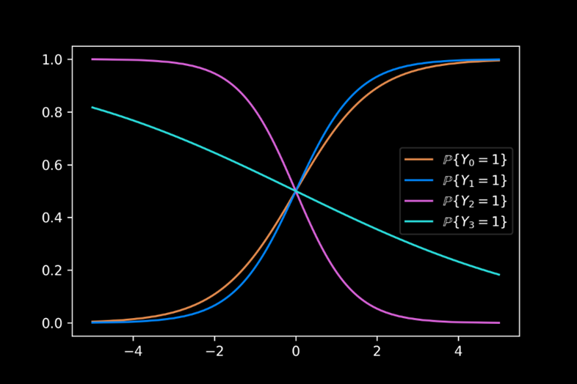
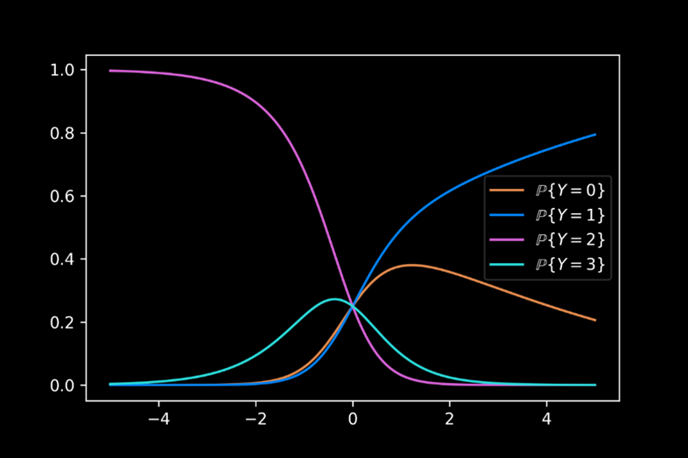
Appendix
Simulation Methods: Multinomial Regression
Example (4 logistic regressions vs multinomial regression):

Slide 82
Appendix
Simulation Methods: Multinomial Regression
Advantages:
Dependence of outcomes is accounted for.
The likelihood of misleading information is significantly reduced.
The model is similar to the original methods, and is easily understood.
Disadvantages:
Determining proper covariates for all possible outcomes is difficult.

Slide 83
Appendix
Simulation Methods: Singular Value Decomposition (SVD)
Key Concept:
Utilize principal component analysis (PCA) via SVD to generate a complete data matrix with imputed elements replacing missing data.
Construction is based upon the principal components that represent key factors in the data.

Slide 84
Appendix
Simulation Methods: Singular Value Decomposition (SVD)
PCA using SVD:
We begin with a data matrix $X$ with $n$ rows and $p$ columns.
Determine the $s$ principal components $(s≤p)$:
Generate the SVD of $X=UΛV^{T}$.
Take the $s$ largest values on the diagonal of $Λ$ to generate the reduced rank diagonal matrix $\hat{Λ}$. Similarly define $\hat{U}$ and $\hat{V}$ to obtain $\hat{X}=\hat{U}\hat{Λ}{\hat{V}}^{T}$.

Slide 85
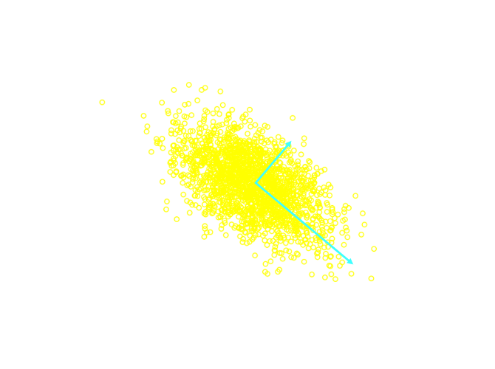
Appendix
Simulation Methods: Singular Value Decomposition (SVD)
PCA Example:
Consider the example with $s=p=2$, with 2000 observations drawn from $N\left(\left(0,0\right),\left(\begin{matrix}1 & 5 \\ −10 & 10\end{matrix}\right)\right)$.
We note that the locations of the PCA vectors are given by $\hat{U}\hat{Λ}$, with the magnitude given by $\hat{V}$.

Slide 86
Appendix
Simulation Methods: Bayesian Principal Component Analysis (BPCA)
Key Concept:
The lack of uncertainty in SVD can be remedied by considering a Bayesian treatment of the imputed data.
This method allows for randomness in each iteration step of the imputation.

Slide 87
Appendix
Simulation Methods: Bayesian Principal Component Analysis (BPCA)
Key Concept:
It is assumed that the data matrix $X=\tilde{X}+E$, where:
$\tilde{X}$ is the signal matrix, estimated by classic PCA.
$E$ is a matrix of random elements, each distributed as $N\left(0, σ^{2}\right)$.
The variance $σ^{2}$ has the least square estimate given by ${\hat{σ}}^{2}=\frac{\sum_{ij}{{\left(x_{ij}−{\hat{x}}_{ij}\right)}^{2}}}{np−\left(p+s\left(n−1+p−s\right)\right)}$, where $x_{ij}$ and ${\hat{x}}_{ij}$ are the respective elements of $X$ and $\hat{X}$.

Slide 88
Appendix
Simulation Methods: Bayesian Principal Component Analysis (BPCA)
Bayesian PCA:
Initialization:
Demean $X$ – Subtract the mean over all non-missing data from each data element.
Estimate $\left({\tilde{X}}^{\left(0\right)},σ^{2,\left(0\right)}\right)=\left(\hat{X},{\hat{σ}}^{2}\right)$, where $\hat{X}$ is the PCA estimate of the demeaned data matrix.

Slide 89
Appendix
Simulation Methods: Bayesian Principal Component Analysis (BPCA)
Bayesian PCA:
Burn In:
This ensures stochastic stationarity of imputation. This is done $K$ times, where $K$ is sufficiently large to achieve stationarity.

Slide 90
Appendix
Simulation Methods: Bayesian Principal Component Analysis (BPCA)
Bayesian PCA:
For each $k=1,…,K$:
I-Step:
Generate $X^{\left(k\right)}={\tilde{X}}^{\left(k−1\right)}+E$.
Restore the mean of $X^{\left(k\right)}$ by adding the mean values subtracted by demeaning.

Slide 91
Appendix
Simulation Methods: Bayesian Principal Component Analysis (BPCA)
Bayesian PCA:
For each $k=1,…,K$:
P-Step:
Demean $X^{\left(k\right)}$.
Compute $\left({\hat{X}}^{\left(k\right)}, {\hat{σ}}^{2, \left(k\right)}\right)$.
Generate new $\tilde{X}$, where each element ${\tilde{x}}_{ij}^{\left(k\right)}$ is drawn from the posterior distribution $N\left({\hat{x}}_{ij}^{\left(k\right)},\frac{{\hat{σ}}^{2,\left(k\right)}}{p}\right)$.

Slide 92
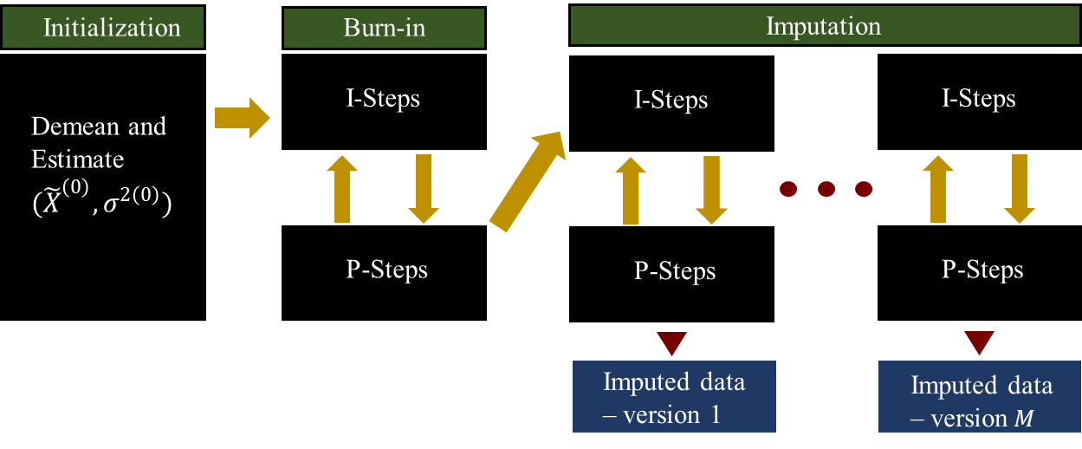
Appendix
Simulation Methods: Bayesian Principal Component Analysis (BPCA)
Example:

Slide 93
Appendix
Simulation Methods: Bayesian Principal Component Analysis (BPCA)
Advantages:
Bayesian PCA can improve upon the standard PCA by accounting for uncertainty in imputation.
Disadvantages:
There is no perfect method for determining $K$, and so, the imputed data may not be stochastically stationary.
Insufficient gap between consecutive versions of imputation can cause dependency between versions.

Slide 94
Appendix
Simulation Methods: Multiple Imputations by Chained Equations (MICE)
Key Concept:
Simultaneously impute multiple variables.
Iteratively consider one variable at a time, using the remaining variables for imputation.
The iteration is stopped when difference in imputed values falls below a set threshold.

Slide 95
Appendix
Simulation Methods: Multiple Imputations by Chained Equations (MICE)
Key Concept:
Initialization:
Begin with simple method (e.g. cell mean) to initialize missing data.
Iteration:
Fix one variable for imputation as missing.
Estimate using regression on remaining variables.
Repeat until the difference in successive values falls below the set threshold.

Slide 96
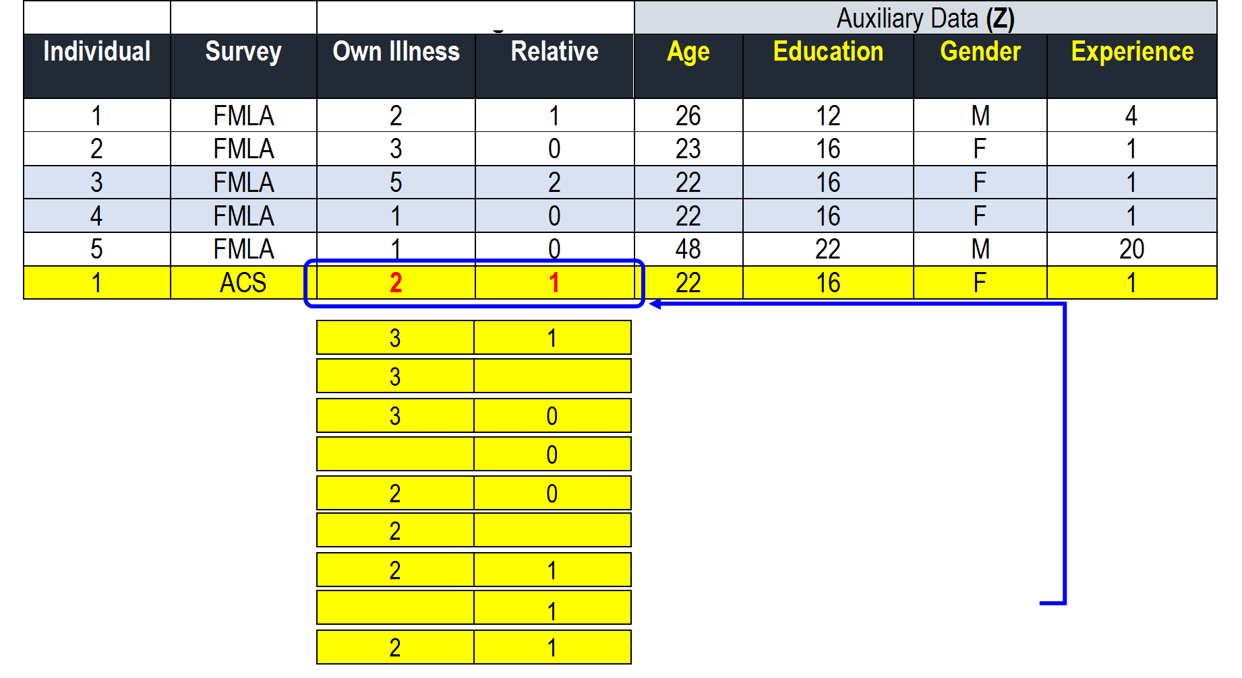
Appendix
Simulation Methods: Multiple Imputations by Chained Equations (MICE)
Example:

Slide 97
Appendix
Simulation Methods: Multiple Imputations by Chained Equations (MICE)
Advantages:
Multiple variables can be imputed simultaneously.
Method relies only on simple imputation methods.
Disadvantages:
Linear regression is restrictive.
Mechanical application may lead to logically inconsistent imputation models.
Time to convergence varies, is generally unknown, and in some cases, can be prohibitively long.

Slide 98
Appendix
Simulation Methods: Chained Equations Using Generalized Linear Models (GLMs)
Key Concept:
The MICE method is restricted to a linear regression, which may not be a proper model for the missing data.
Generalizes the MICE method by allowing for a generalized linear model (GLM).
Such models include ordinary least squares (OLS), log-linear models, and exponential model.

Slide 99
Appendix
Simulation Methods: Chained Equations Using Generalized Linear Models (GLMs)
Advantages:
In addition to those of the general MICE, this method offers better flexibility, which may lead to better simulation performance.
Disadvantages:
With the exception of the model restriction to a linear regression, this method has the same disadvantages as the MICE.

Slide 100
Appendix
Simulation Methods: Chained Equations Using Classification and Regression Trees
Key Concept:
Improve upon the MICE method through the use of regression tress.
The use of regression trees will account for conditional behavior in leave taking that is missed by standard regression.

Slide 101
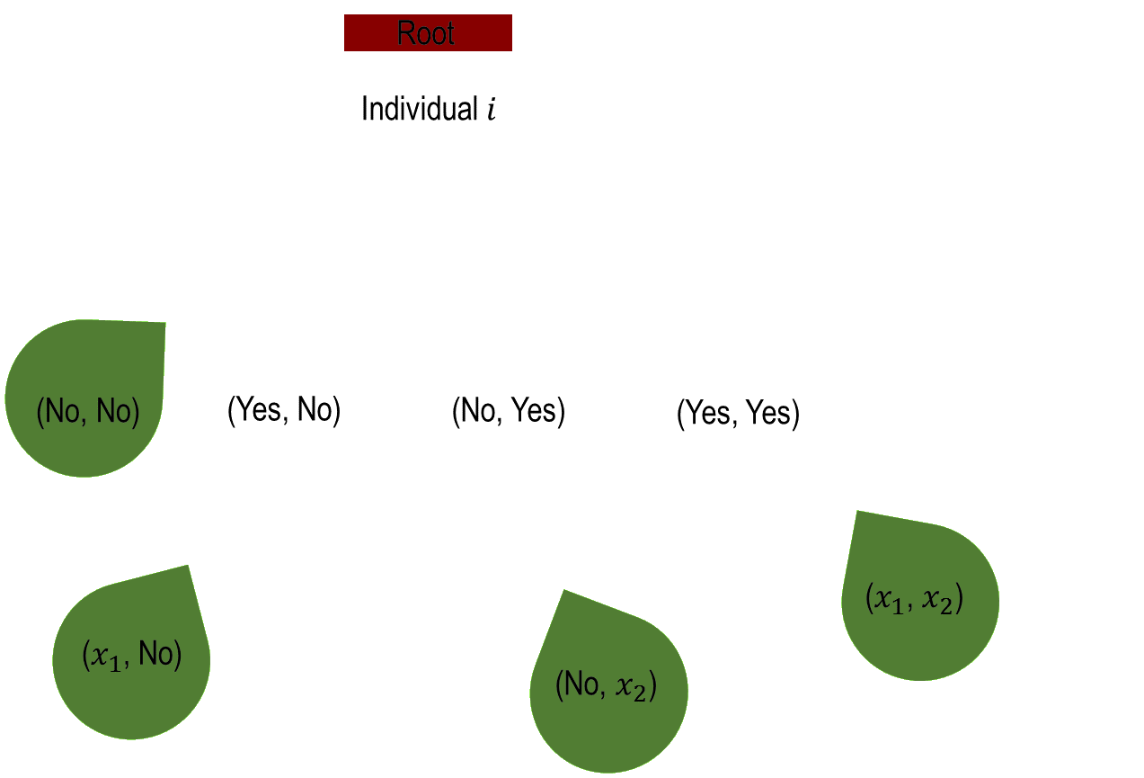
Appendix
Simulation Methods: Chained Equations Using Classification and Regression Trees
Example:

Slide 102
Appendix
Simulation Methods: Chained Equations Using Classification and Regression Trees
Advantages:
In addition to those of the general MICE, this method further considers conditional behavior in leave taking.
Disadvantages:
Risk of excessive complexity of tree structure can result in results that are difficult to determine.

Slide 103
Appendix
Simulation Methods: Fully Bayesian Joint Distribution Based on Dirichlet Process Mixture Models
Key Concept:
Method used to impute multiple variables.
Imputes one variable at a time, conditional on the most recent information available for all variables.
Iterative values are determined according to a posterior joint distribution that is conditional on the most recent information for all data.

Slide 104
Appendix
Simulation Methods: Fully Bayesian Joint Distribution Based on Dirichlet Process Mixture Models
Key Concept:
In addition to the Bayesian joint distribution, this method allows for a hierarchical component to be imposed.
This allows for a further level of stochasticity associated to the posterior joint distribution parameters.

Slide 105
Appendix
Simulation Methods: Fully Bayesian Joint Distribution Based on Dirichlet Process Mixture Models
Key Concept:
For example, suppose that the number of leaves taken for a given leave type follows a multinomial distribution with $N$ possible outcomes and with parameters $\left(λ_{1},…,λ_{N}\right)∼Dirichlet\left(\frac{1}{N}⋅1_{N},α\right)$, where
$1_{N}$ is a length $N$ vector of ones.
$α$ is the scaling parameter.

Slide 106
Appendix
Simulation Methods: Fully Bayesian Joint Distribution Based on Dirichlet Process Mixture Models
Advantages:
Allowing for the modeling of both the uncertainty related to sampling, as well as that related to the distribution from which the samples are taken.
Allows for a confidence interval associated to the imputed values, as opposed to a fixed deterministic estimate.
Allows for a very accurate imputation.

Slide 107
Appendix
Simulation Methods: Fully Bayesian Joint Distribution Based on Dirichlet Process Mixture Models
Disadvantages:
As with the Bayesian PCA, this method is subject to the risk associated with insufficient burn-in as well as insufficient space between imputation draws.

Slide 108
Regression-based performance
Predicting leave behavior: Logistic Regression
Logistic regression is highly dependent upon:
Prevalence – The count of “positive” outcomes.
Magnitude – The covariate values associated to positive outcomes.

